Slide 1

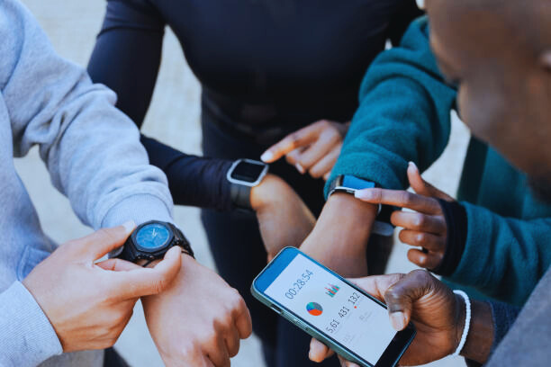
Personal Fitness Tracker Using Python
This project develops a Personal Fitness Tracker using Python and Machine Learning.
Provides personalized fitness insights and recommendations.
Uses models like SVM, Logistic Regression, and Random Forest to analyze user data.
Offers tailored feedback and progress visualization.
By Kumkum Chaudhary

Slide 2


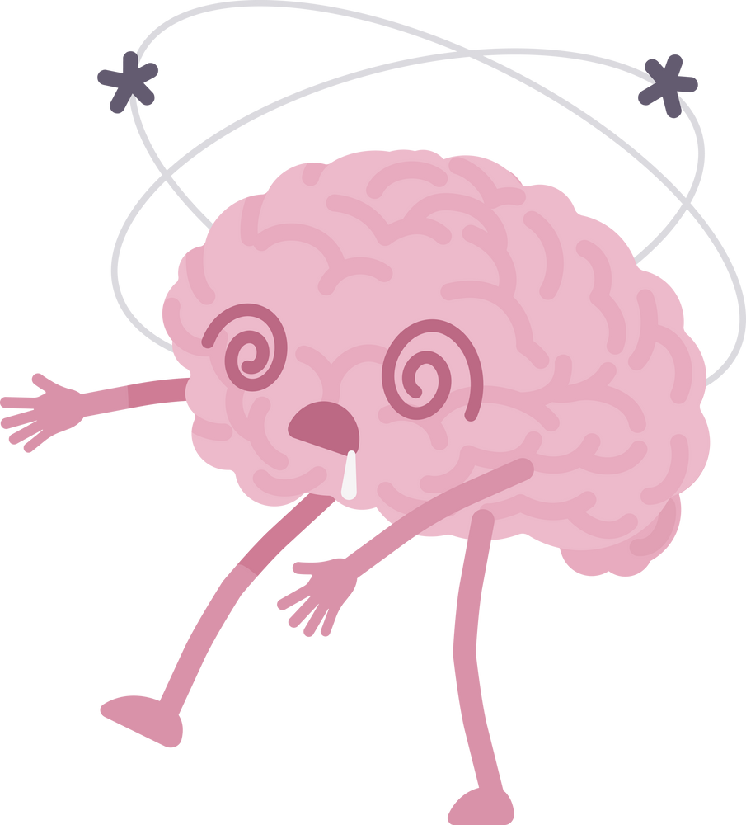

PROBLEM STATEMENT:
Manual fitness tracking is inefficient, time-consuming, and prone to errors.
Most fitness applications provide one-size-fits-all recommendations instead of personalized insights.
There is a need for AI-driven solutions that can accurately predict calorie burn, monitor progress, and offer personalized feedback.
Lack of real-time tracking and visualization tools makes it difficult to assess fitness goals effectively.

Slide 3


PROPOSED SOLUTION:
A Personal Fitness Tracker that uses Machine Learning (ML) to provide accurate and personalized fitness recommendations.
Utilizes Random Forest Regressor, a robust ML model for estimating calorie burn based on various parameters such as age, weight, gender, exercise type, and duration.
Built using Streamlit, ensuring an interactive and user-friendly web application.
Provides real-time insights to help users make data-driven fitness decisions.
Enables progress tracking and visualization for improved motivation and goal-setting.

Slide 4



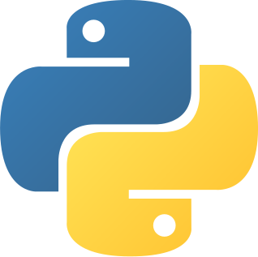

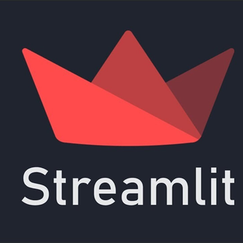
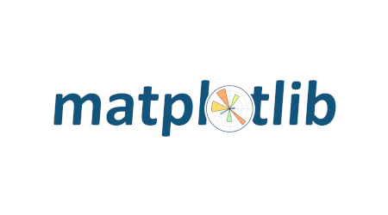
Software Requirement:
Programming Language: Python
Libraries Used:
Scikit-learn – Machine learning model training and evaluation
Pandas & NumPy – Efficient data handling and processing
Matplotlib & Seaborn – Data visualization for user insights
Streamlit – Web-based application framework
Platform: Web-based application hosted on Streamlit Cloud for easy access and deployment
Dataset Used: Fitness activity dataset containing workout details and calorie expenditure
WEB DEVELOPMENT:

Slide 5
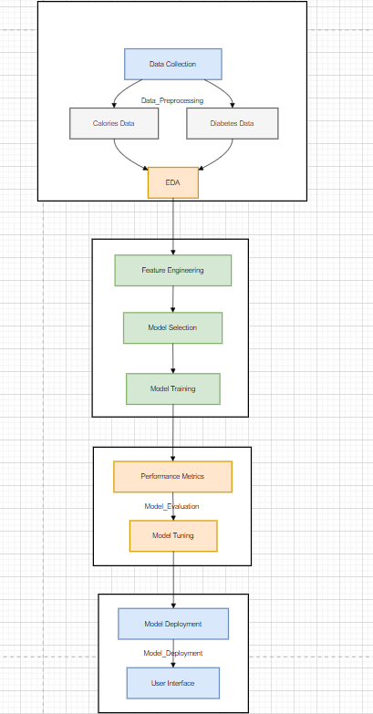
System Architecture:

Slide 6
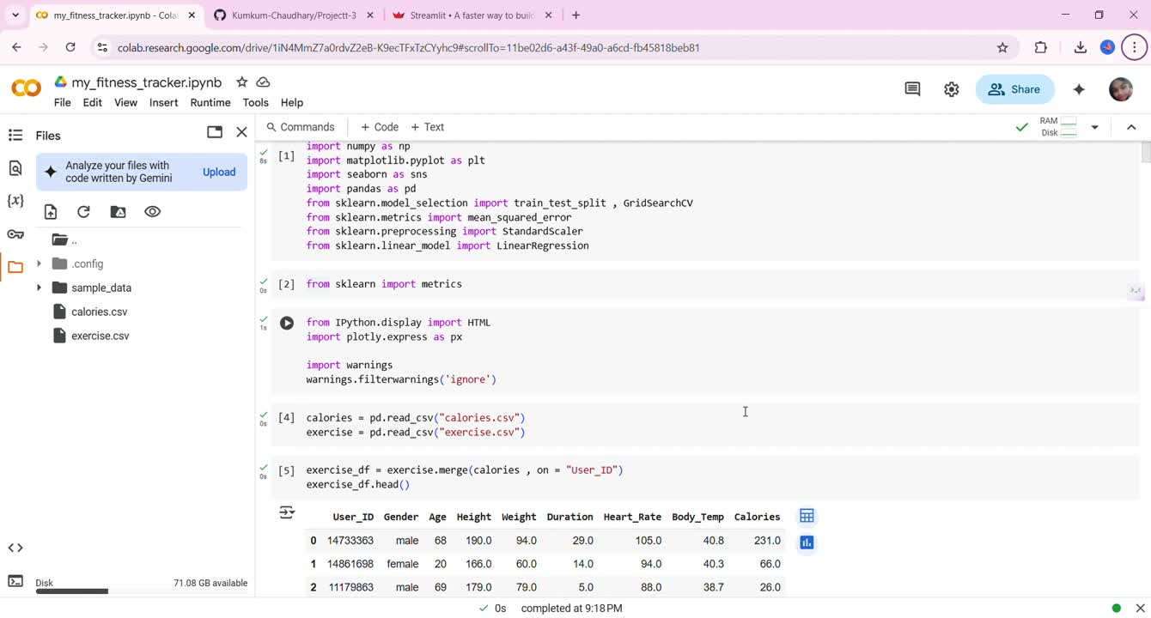

Deployment Video:

Slide 7
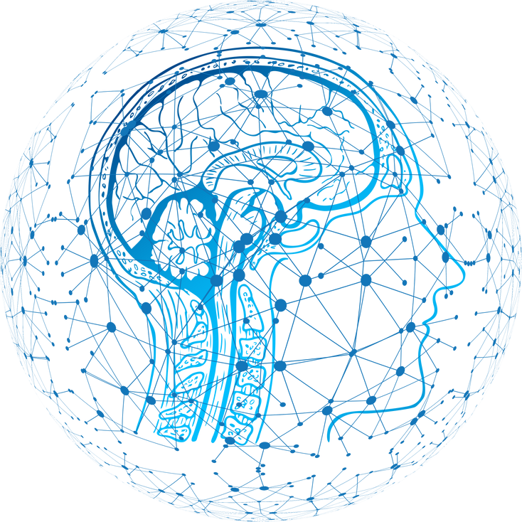
FUTURE SCOPE:
Integration with Wearable Devices:
Connect with smartwatches and fitness bands for real-time tracking.
AI-powered Workout & Nutrition Recommendations:
Suggest customized workout plans based on user progress.
Integrate diet tracking for a holistic fitness experience.
Cloud-based Storage & Multi-Device Access:
Store user fitness data securely on the cloud.
Enable access from multiple devices for seamless tracking.
Gamification & Community Features:
Introduce leaderboards and fitness challenges to enhance engagement.

Slide 8
Conclusion:
The Personal Fitness Tracker enhances fitness monitoring and calorie estimation using Machine Learning.
Offers a personalized and real-time approach to fitness tracking.
Provides a user-friendly interface via Streamlit.
Future enhancements include wearable integration, AI-powered insights, and cloud-based storage.
Helps users achieve their fitness goals with better data-driven decision-making.

Slide 9


THANK YOU

